Slide 1

Welcome PARENTS to Middle School!
We’re in this together!
​

Slide 2

Who’s Who of
Mad Beach
Principal: Mr. Ateek
Assistant Principals: Mrs. Altenore and Mrs. Crandall
School Counselors: Mrs. Vermillion (last names A-K) and Mr. Rosenberger (last names L-Z)
School Nurse: Nurse Kendra
Office Support: Mrs. Ivy, Mrs. Bandoni, & Ms. Frey
*If you’re dropping your child off late or picking up early, you’ll go through the front office

Slide 3

Tips for being a Fundamental Parent
- Check Focus & Canvas regularly. Be sure to use your child’s username and password.
Be sure you’re attending one school-approved function a month. We have many options to help you fit this into your life.
Reporting an absence: Call the front office or use the link on our website to report student absences
When in doubt, sign it! Sign all homework everyday! Be sure to sign quarterly progress reports.
- Adhere to homework/classwork and discipline guidelines.
- Check your child’s agenda daily. If your kiddo isn’t using it, we promise this will eventual come back to haunt him/her.
- Parents provide transportation to and from school. Check into a carpool group. Though our school is amazing, you’re not going to love us for our carline.
- Understand all aspects of the Student Code of Conduct. Support the student dress code!

Slide 4

Parent Meetings
MADEIRA BEACH FUNDAMENTAL GENERAL MEMBERSHIP MEETING RESPONSIBILITIES 2023- 2024
As a requirement of the fundamental program, every parent/guardian must attend either a Parent Teacher Student Association sponsored event, (PTSA), School Advisory Council (SAC)/ Parent University meeting, or other general membership opportunities monthly, attending a total of six of eight general membership meetings over the school year (August- May). You will only receive one meeting credit per month. Meetings last approximately one hour (not to exceed 90 minutes) and parents/guardians are expected to be present for the entire meeting. Arriving late, leaving early, or failure of a parent/guardian to sign in, will result in the meeting being counted as unattended. If a parent does not attend a membership opportunity in a given month, they may not make up the missed credit by attending two opportunities in the next month.

Slide 5
- No homework or incomplete homework = 2 demerits
- No parent signature on homework = 1 demerit
Not bringing materials to class = 1 demerit
12 demerits in a grading period = IAC
Demerits
Detentions
Detentions may be given for breaking the School Code of Conduct.
Some common reasons include, but are not limited to: gum, missing parent signatures on progress report, rude behavior towards others
There is a 10 day grace period to help you get acclimated
10 Detentions in a school year = IAC

Slide 6
Dress
Code
Students in the fundamental schools are expected to exercise good judgment and dress in a responsible manner
Students violating the dress code will be sent to the office to call their parents and request a change of clothing.
The student may be issued a warning or a detention for violation of the dress code policy. Repeated violations may result in a referral to the school’s Intervention and Appeal Committee.

Slide 7


Acceptable Dress:
Dresses or skirts may be no shorter than 3” above the knee (including when leggings or jeggings are worn underneath). Top of the slit in a skirt may be no more than 3” above the knee.
Shirts, blouses and/or sweaters for both boys and girls – at no time should bare midriff be exposed including sitting, bending, standing or raising your hands over your head. - All shirts, tops, and dresses shall have sleeves and cover the shoulders.
Shoes with some form of heel strap
“

Slide 8

We also expect parents to use good judgment when volunteering in and/or visiting the school, and dress in a manner consistent with the student dress code.
Shorts my only be uniform shorts, of proper length and in the one of the following colors: khaki, navy blue or black
Shirts must have sleeves (no tank tops)
No hats
No flip-flops, Crocs, sandals without straps
No tops with a plunging neckline
No visible body piercing (except ears)
No writing or drawings on the body
No loungewear (such as pajamas or yoga pants), spandex or jeggings
No clothes with holes, tears or are see-through
No unnatural hair color (to include streaks)

Slide 9

Cell phones
*Cell phones and other electronics are prohibited
**Parents are advised that the best way to get in touch with their child during the school day is by calling the child’s school office.
A student may possess a cell phone and other electronic devices in school, on school property, at school-related functions, provided these items are powered off and concealed from view while school is in session.
PROGRESSIVE STEPS FOR VIOLATION OF GUIDELINES
First offense – confiscation, parent/guardian notification, (K5 warning notice/ MS report notice)
Second offense – confiscation/ student pick up at end of day, detention
3. Progressive discipline steps

Slide 10
Overpass & Social Media
*These two areas are our biggest behavior issues
Social media and cell phones are here to stay, but there are major cautions to watch out for:
  Cyberbullying
  Privacy/Safety
  Mental Health
  Time Drain
The overpass should ONLY be used by students who live in those neighborhoods
Your families will sign that they will not use the businesses across the streetas a second carline
Please monitor your student’s online activity!

Slide 11

Intervention & Appeal Committee (IAC)
A student/family will be referred to IAC for violations of the fundamental agreement. The IAC committee will make an official recommendation, which may include: no action, probation or dismissal.
Reasons for student referrals to the committee include but are not limit to: excessive demerits, excessive detentions or tardies, upon receiving two referrals in a grading period, upon receiving one suspension or work detail, upon serious violation of the Code of Student Conduct, parent not meeting parent requirements, or at the request of an administrator.
*We’re always looking for parents to volunteer on our IAC committee

Slide 12



Common
Fears of a Middle Schooler
Finding all 7 classes/Getting to class on time
Making new friends
Bullying/Mean kids
Dressing for PE
Keeping up with schoolwork/School being too hard

Slide 13
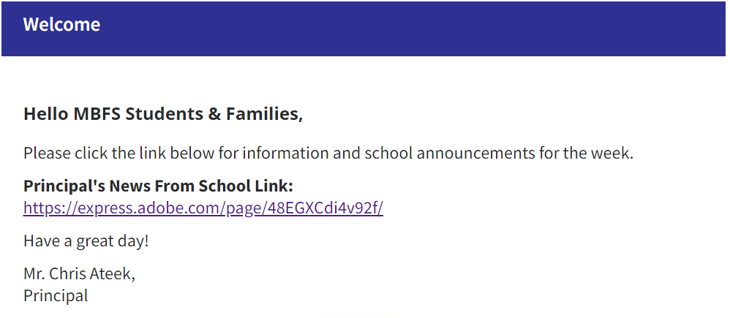

Principal News
Please Bookmark Principal’s News From School Link!
School Website:
https://www.pcsb.org/mb-ms
Mr. Ateek’s Link:
https://express.adobe.com/page/48EGXCdi4v92f/

Slide 14
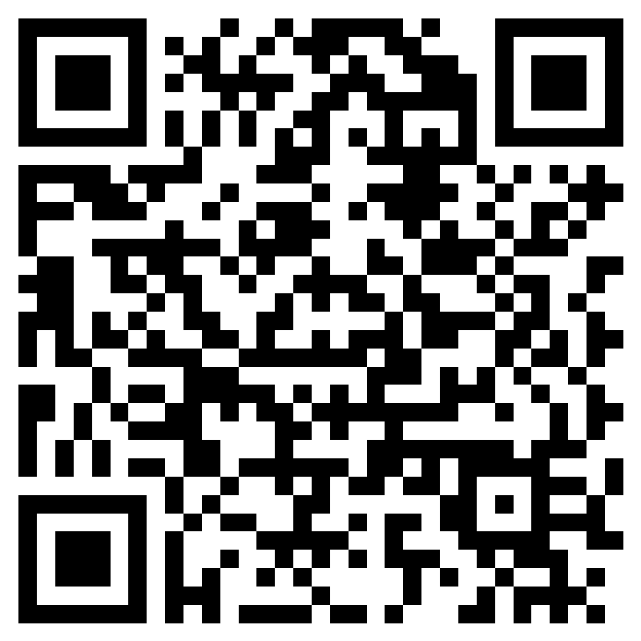

Questions or Concerns?
*We know this is a new chapter in your family’s life, so it’s okay and completely normal to feel nervous. Just remember it takes a village to raise a child. We are in this together!
Have a question or concern? Click this QR code for our form and we will get back to you as soon as we can

Slide 15


Tour Time
Walk the campus/walk your child’s schedule
Middle school Café: After school options/care
Media Center:
  - PTSA Spirit wear for sale
- Mandatory Technology forms

